Slide 1
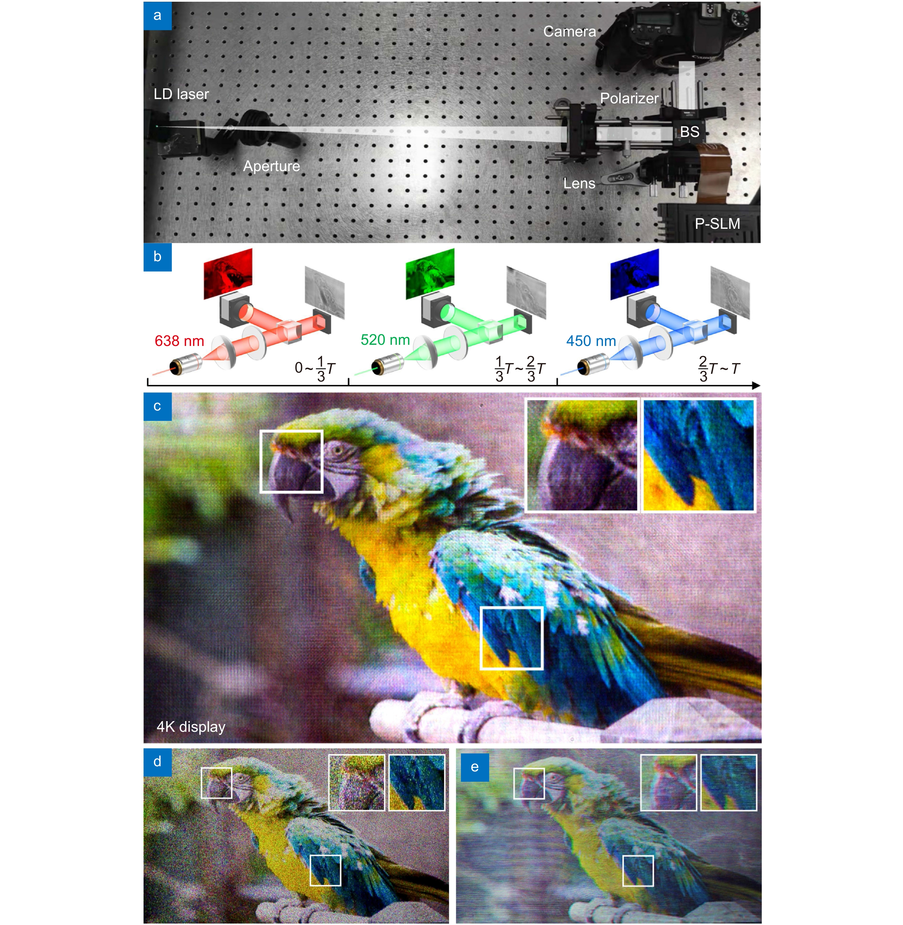
Figure 7. (a) Photograph of the experimental setup. (b) Schematic diagram of the time multiplexing method for full-color display. (c) Full-color 4K optical reconstruction by 4K-DMDNet and its detail views. (d) Optical reconstruction by GS algorithm. (e) Optical reconstruction by Holo-Encoder.
Kexuan Liu,Jiachen Wu,Zehao He,Liangcai Cao
4K-DMDNet: diffraction model-driven network for 4K computer-generated holography
https://doi.org/10.29026/oea.2023.220135

